Slide 1

Sheet2 : Search A*
Eng. Abdulrahman ElMadkhoum

Slide 2
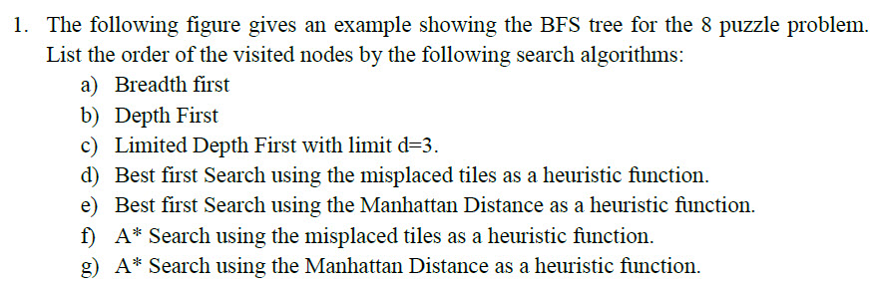
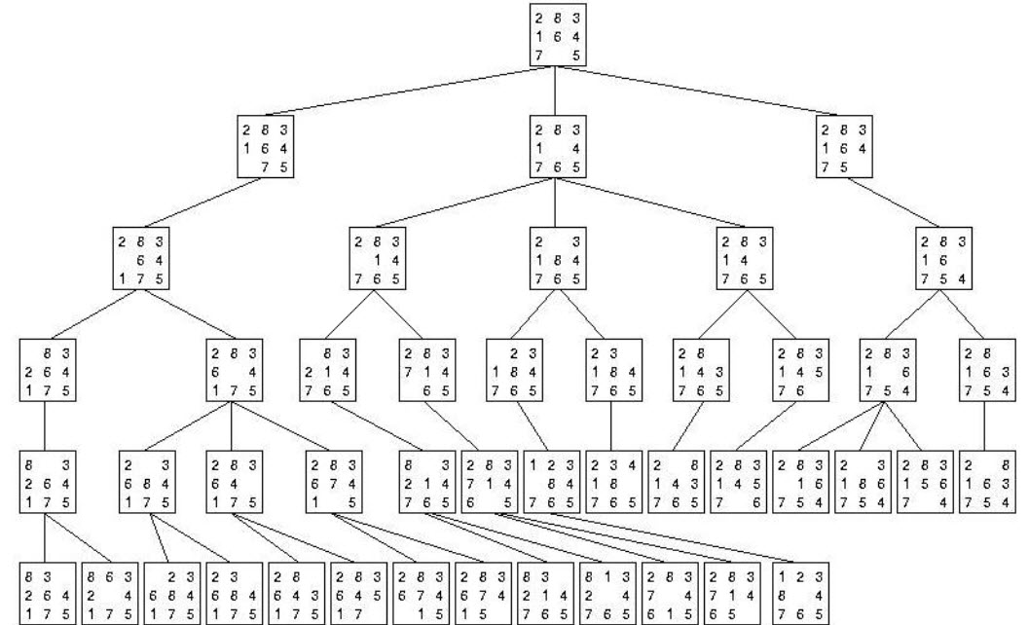

Slide 3
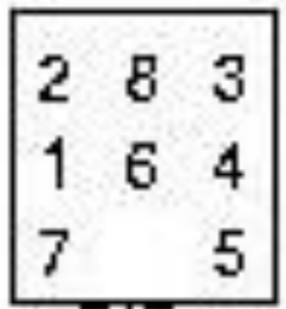
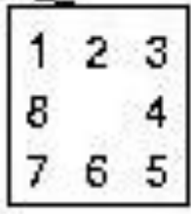
Initial State
Goal State

Slide 4
f) A* using misplaced tiles as heuristic function

Slide 5
A* using misplaced tiles as heuristic function
Total Cost of a Node in A* = Heuristic + Cost
f(n) = h(n) + g(n)

Slide 6
First, Calculate Heuristic using Misplaced Tiles
Initial State
Goal State
1 is misplaced
2 is misplaced
3 is ok
4 is ok
5 is ok
6 is misplaced
7 is ok
8 is misplaced
So, heuristic here = 1+1+1+1 =4
H(n)=4
H(n) = 0

Slide 7
Then , Add the number of steps to the heuristic
1+1+1+1+ 0= 4
1+1+1+1+1+1=6
1+1+1+1
=4
1+1+1+1+1+1=6
The difference between Best first and A*
Best First
Total Cost of a Node
= Heuristic Only
A*
Total Cost of a Node
= Heuristic + Cost
Heuristic is calculated using Misplaced or Manhattan or other methods
Cost depends on the problem type
In 8 puzzle problem the cost to move from one node to another is 1

Slide 8
1+1+1+1 = 4
1+1+1+1+1+1=6
1+1+1+1
=4
1+1+1+1+1+1=6
We Choose the Node with the least
Heuristic + Cost in the whole tree

Slide 9
D
1+1+1+1 = 4
1+1+1+1+1+1=6
1+1+1+1
=4
1+1+1+1+1+1=6
1+1+1
+2=5
1+1+1
+2=5
1+1+1+1
+2=6
There are Two nodes with the same Total cost

Slide 10
D
1+1+1+1 = 4
1+1+1+1+1+1=6
1+1+1+1
=4
1+1+1+1+1+1=6
1+1+1
+2=5
1+1+1
+2=5
1+1+1+1
+2=6
old
new
We Choose the Older one (The one we drew First)

Slide 11
1+1+1+1 = 4
1+1+1+1+1+1=6
1+1+1+1
=4
1+1+1+1+1+1=6
1+1+1
+2=5
1+1+1
+2=5
1+1+1+1
+2=6

Slide 12
1+1+1+1 = 4
1+1+1+1+1+1=6
1+1+1+1
=4
1+1+1+1+1+1=6
1+1+1
+2=5
1+1+1
+2=5
1+1+1+1
+2=6
1+1+1
+3=6
1+1+1+1+3=7

Slide 13
1+1+1+1 = 4
1+1+1+1+1+1=6
1+1+1+1
=4
1+1+1+1+1+1=6
1+1+1
+2=5
1+1+1
+2=5
1+1+1+1
+2=6
1+1+1
+3=6
1+1+1+1+3=7
The Least Cost is not always at the current level , look at the previous levels

Slide 14
1+1+1+1 = 4
1+1+1+1+1+1=6
1+1+1+1
=4
1+1+1+1+1+1=6
1+1+1
+2=5
1+1+1
+2=5
1+1+1+1
+2=6
1+1+1
+3=6
1+1+1+1+3=7

Slide 15
1+1+1+1 = 4
1+1+1+1+1+1=6
1+1+1+1
=4
1+1+1+1+1+1=6
1+1+1
+2=5
1+1+1
+2=5
1+1+1+1
+2=6
1+1+1
+3=6
1+1+1+1+3=7
1+1+1+1+3=7
1+1+3=5

Slide 16
1+1+1+1 = 4
1+1+1+1+1+1=6
1+1+1+1
=4
1+1+1+1+1+1=6
1+1+1
+2=5
1+1+1
+2=5
1+1+1+1
+2=6
1+1+1+1+3=7
1+1+3=5
1+1+1
+3=6
1+1+1+1+3=7
1+4=5

Slide 17
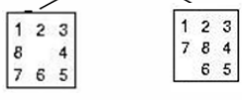
1+1+1+1 = 4
1+1+1+1+1+1=6
1+1+1+1
=4
1+1+1+1+1+1=6
1+1+1
+2=5
1+1+1
+2=5
1+1+1+1
+2=6
1+1+1+1+3=7
1+1+3=5
1+1+1
+3=6
1+1+1+1+3=7
1+4=5
Goal Reached
Stop
0+5=5
1+1
+5= 7

Slide 18
g) A* using Manhattan Distance as heuristic function

Slide 19
First, Calculate Heuristic using Manhattan Distance
Initial State
1 needs 1 movement to be in it’s correct position
2 needs 1 movement to be in it’s correct position
3 is in it’s correct position
4 is in it’s correct position
5 is in it’s correct position
6 needs 1 movement to be in it’s correct position
7 is in it’s correct position
8 needs 2 movements to be in it’s correct position
So, The Heuristics is = 1+1+1+2 = 5
H(n) = 0

Slide 20
Then , Add the number of steps to the heuristic

Slide 21
1+1+1+1+2
= 5
2+1+2
+2=7
1+1+1
+2=5
1+1+1+2
+2=7
1+1+3=5
1+1+1+1+3=7
1+4=5
0+5=5

Slide 22
1+1+1+1+2
= 5
1+1+1+1+2
+1=7
1+1+2
+1=5
1+1+1+1+2
+1=7
2+1+2
+2=7
1+1+1
+2=5
1+1+1+2
+2=7
1+1+3=5
1+1+1+1+3=7
1+4=5
0+5=5

Slide 23
1+1+1+1+2
= 5
1+1+1+1+2
+1=7
1+1+2
+1=5
1+1+1+1+2
+1=7
1+1+3=5
1+1+1+1+3=7
1+4=5
0+5=5

Slide 24
1+1+1+1+2
= 5
1+1+1+1+2
+1=7
1+1+2
+1=5
1+1+1+1+2
+1=7
2+1+2
+2=7
1+1+1
+2=5
1+1+1+2
+2=7
1+1+3=5
1+1+1+1+3=7
1+4=5
0+5=5

Slide 25
1+1+1+1+2
= 5
1+1+1+1+2
+1=7
1+1+2
+1=5
1+1+1+1+2
+1=7
2+1+2
+2=7
1+1+1
+2=5
1+1+1+2
+2=7
1+1+3=5
1+1+1+1+3=7
1+4=5
0+5=5

Slide 26
1+1+1+1+2
= 5
1+1+1+1+2
+1=7
1+1+2
+1=5
1+1+1+1+2
+1=7
2+1+2
+2=7
1+1+1
+2=5
1+1+1+2
+2=7
1+1+3=5
1+1+1+1+3=7
1+4=5
0+5=5

Slide 27
1+1+1+1+2
= 5
1+1+1+1+2
+1=7
1+1+2
+1=5
1+1+1+1+2
+1=7
2+1+2
+2=7
1+1+1
+2=5
1+1+1+2
+2=7
1+1+3=5
1+1+1+1+3=7
1+4=5
0+5=5

Slide 28
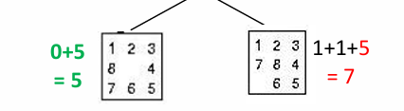
1+1+1+2
= 5
1+1+1+1+2
+1=7
1+1+2
+1=5
1+1+1+1+2
+1=7
2+1+2
+2=7
1+1+1
+2=5
1+1+1+2
+2=7
1+1+3=5
1+1+1+1+3=7
1+4=5
Goal Reached
Stop

Slide 29
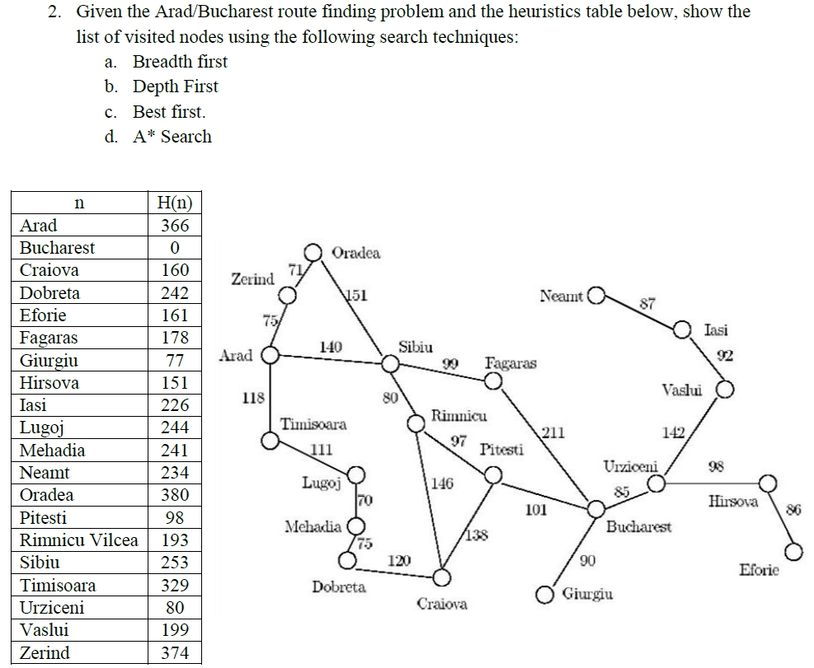
Question 2

Slide 30
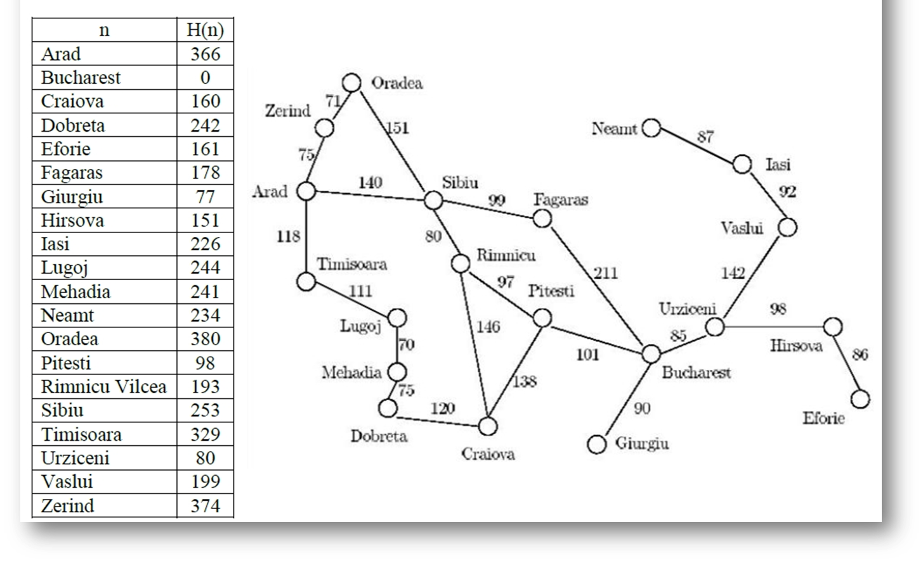
In this question the heuristic value is given in the table and the cost values are in the map f(n)= H(n) + g(n)

Slide 31
1. Given the Arad/Bucharest route finding problem and the heuristics table below, show the list n of visited nodes using the following search techniques:
A*
A
140
75
118
S
T
Z
118 +329 = 447
140 +253 = 393
75 +374 = 449

Slide 32
1. Given the Arad/Bucharest route finding problem and the heuristics table below, show the list n of visited nodes using the following search techniques:
A*
A
140
75
118
393
S
T
Z
447
449
99
151
80
F
O
R
(140+80) +193 = 413
(140+99) +178 = 417
(140+151) +380 = 671

Slide 33
1. Given the Arad/Bucharest route finding problem and the heuristics table below, show the list n of visited nodes using the following search techniques:
A*
A
140
75
118
393
S
T
Z
447
449
99
151
80
F
O
R
413
671
417
97
146
C
P
(140+80+146) +160 = 526
(140+80+97) +98 = 415

Slide 34
1. Given the Arad/Bucharest route finding problem and the heuristics table below, show the list n of visited nodes using the following search techniques:
A*
A
140
75
118
393
S
T
Z
447
449
99
151
80
F
O
R
413
671
417
97
146
C
P
415
526
101
138
(140+80+97+138) +160 = 615
(140+80+97+101) +0 = 418
B
C

Slide 35
1. Given the Arad/Bucharest route finding problem and the heuristics table below, show the list n of visited nodes using the following search techniques:
A*
A
140
75
118
393
S
T
Z
447
449
99
151
80
F
O
R
413
671
417
97
146
C
P
415
526
101
138
B
C
Reached Goal but it doesn’t have the least Total Cost
418
615

Slide 36
1. Given the Arad/Bucharest route finding problem and the heuristics table below, show the list n of visited nodes using the following search techniques:
A*
A
140
75
118
393
S
T
Z
447
449
99
151
80
F
O
R
413
671
417
97
146
C
P
415
526
211
101
138
B
B
C
418
615
(140+99+211) +0 = 450

Slide 37
1. Given the Arad/Bucharest route finding problem and the heuristics table below, show the list n of visited nodes using the following search techniques:
Order : A ,S, R,P,F,B
Path : A,S,R,P,B
A*
A
140
75
118
393
S
T
Z
447
449
99
151
80
F
O
R
413
671
417
97
146
C
P
415
526
211
101
138
B
B
C
Now the Goal Node is the one with the least Cost in the Whole Tree Stop
418
615
450

Slide 38
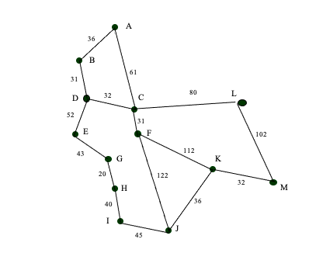
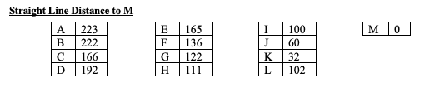
Using the A* algorithm work out a route from town A to town M. Use the following cost functions.

Slide 39
A*
A
36
61
222+36= 258
61+166= 227
B
C

Slide 40
A*
A
36
61
258
B
C
227
(61+80) +102 = 243
32
80
(61+32) +192 = 285
31
D
F
L
(31+61)+136= 228

Slide 41
A*
A
36
61
258
B
C
227
32
80
31
285
228
243
D
F
L
122
112
(61+31+122) +60 =274
J
K
(61+31+ 112) +32= 236

Slide 42
A*
A
36
61
258
B
C
227
32
80
31
285
228
243
D
F
L
122
112
274
J
236
K
36
32
(61+31+ 112 +36) + 60= 300
J
M
(61+31+ 112 +32) + 0= 236

Slide 43
A*
A
258
B
C
227
285
228
243
D
F
L
274
J
236
K
Order: A, C, F, K, M
J
M
300
236
Path: A, C, F, K, M

